Slide 1

September
Septiembre

Slide 2
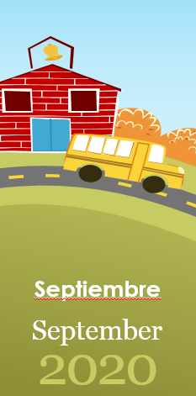
Jueves
10

Slide 3
Días de la Semana
Domingo
Lunes
Martes
Miércoles
Jueves
Viernes
Sábado

Slide 4
Miércoles
Jueves
Viernes

Slide 5

Publisher:
Little, Brown Books for Young Readers
Notes:
Hibernation is a type of deep sleep an animal enters
Winters is the time when the food becomes scarce.

Slide 6
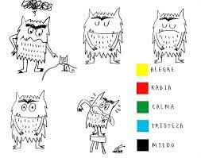
Notes:
Hibernation is a type of deep sleep an animal enters
Winters is the time when the food becomes scarce.

Slide 7
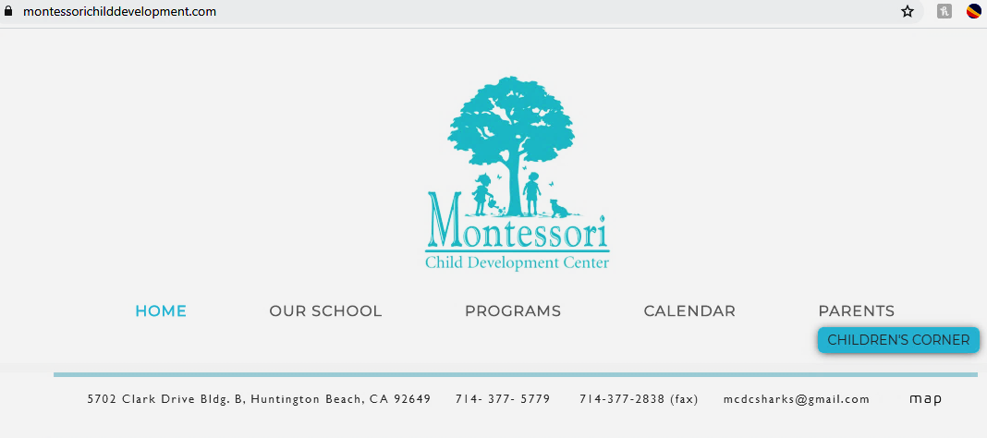
Send your pics
Notes:
Hibernation is a type of deep sleep an animal enters
Winters is the time when the food becomes scarce.

