Slide 1

September
Septiembre

Slide 2
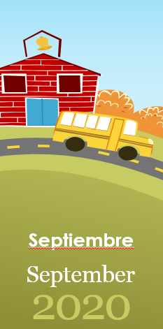
Martes
15

Slide 3
Días de la Semana
Domingo
Lunes
Martes
Miércoles
Jueves
Viernes
Sábado

Slide 4
Lunes
Martes
Miércoles

Slide 5
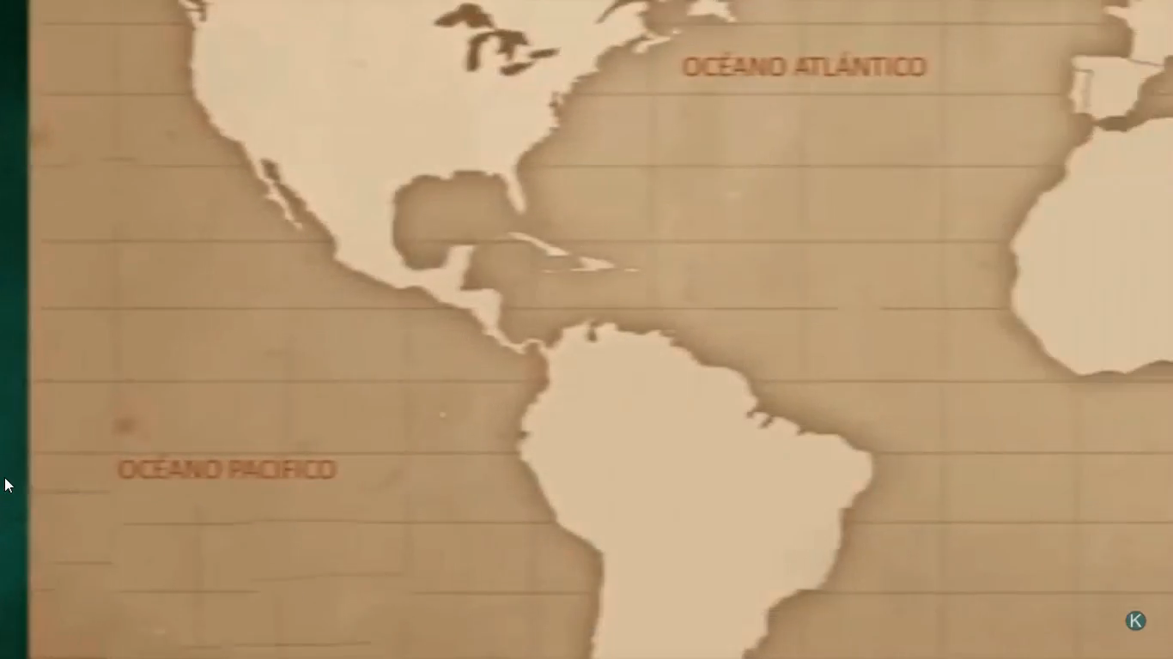
Notes:
Hibernation is a type of deep sleep an animal enters
Winters is the time when the food becomes scarce.

Slide 6









Día de la Independencia
El Salvador
Guatemala
Mexico
Nicaragua
Brasil
Chile
Honduras
Costa Rica
Belice
Notes:
Hibernation is a type of deep sleep an animal enters
Winters is the time when the food becomes scarce.

Slide 7
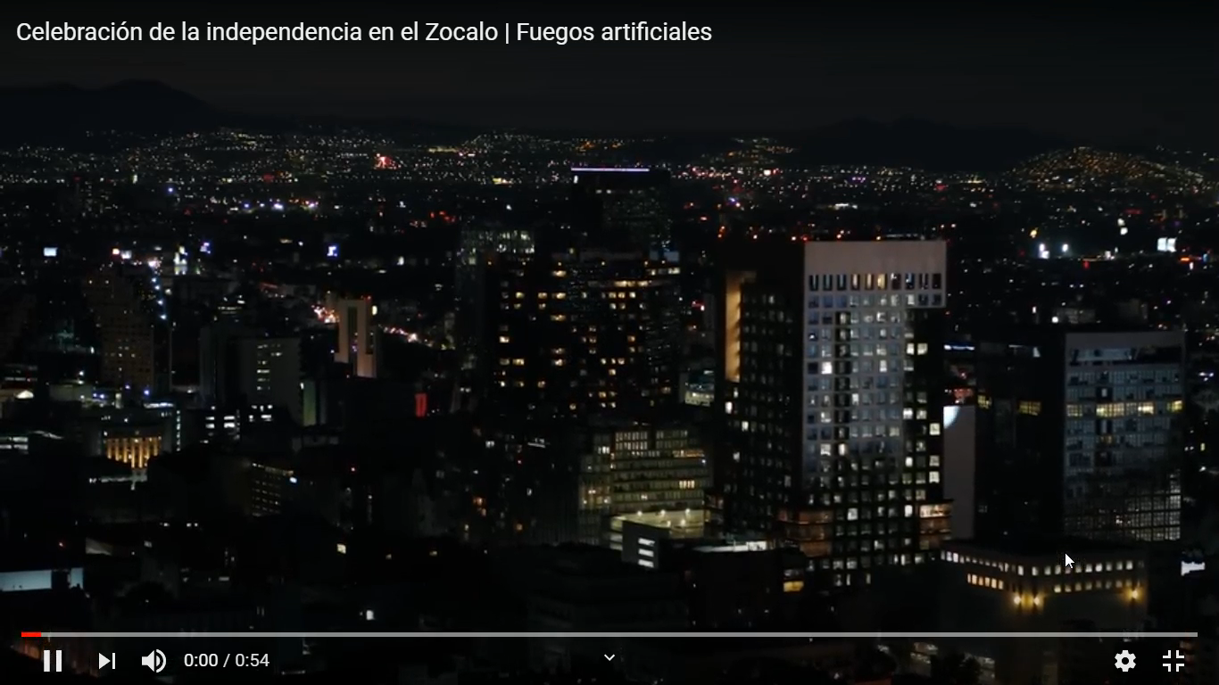
Notes:
Hibernation is a type of deep sleep an animal enters
Winters is the time when the food becomes scarce.

Slide 8
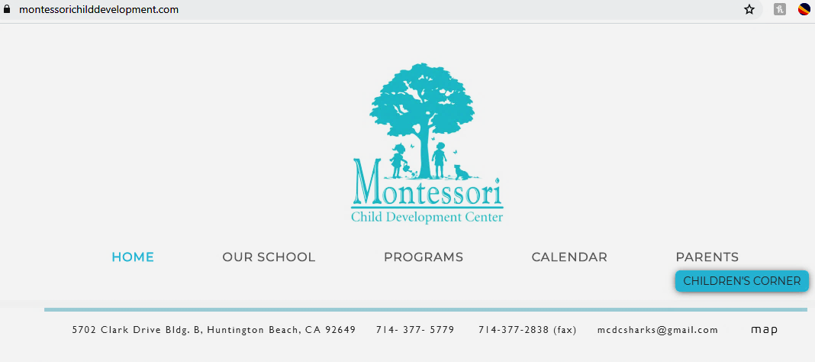
Send your pics
Notes:
Hibernation is a type of deep sleep an animal enters
Winters is the time when the food becomes scarce.

