Slide 1

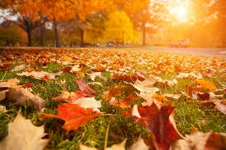
September
Septiembre

Slide 2
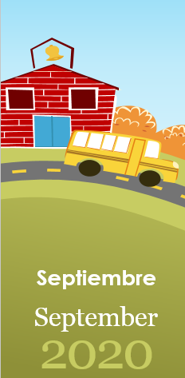
Martes
22
Otoño

Slide 3
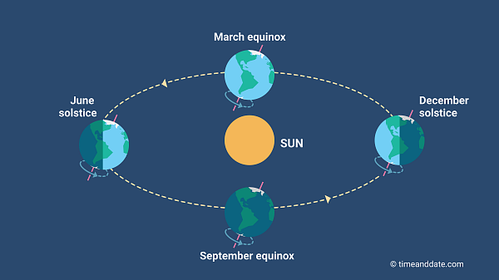

Slide 4
Días de la Semana
Domingo
Lunes
Martes
Miércoles
Jueves
Viernes
Sábado

Slide 5
Lunes
Martes
Miércoles

Slide 6
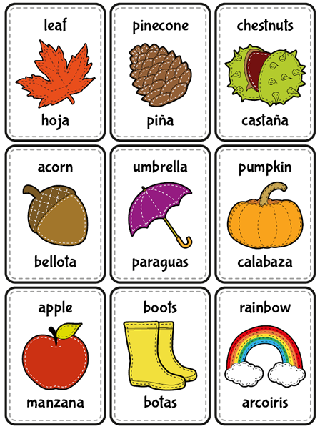
Notes:
Hibernation is a type of deep sleep an animal enters
Winters is the time when the food becomes scarce.

Slide 7
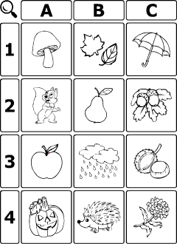
Notes:
Hibernation is a type of deep sleep an animal enters
Winters is the time when the food becomes scarce.

Slide 8
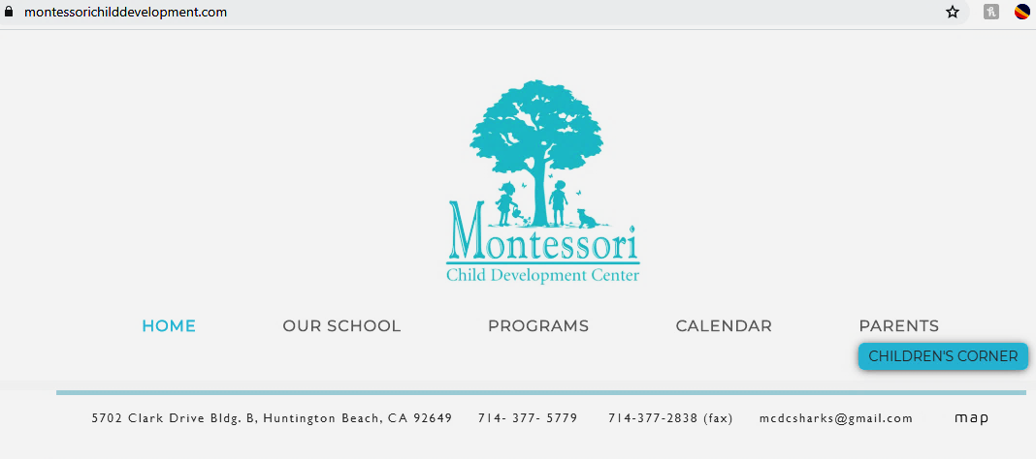
Send your pics
Notes:
Hibernation is a type of deep sleep an animal enters
Winters is the time when the food becomes scarce.

