Slide 1
April
Domingo
Lunes
Martes
Miércoles
Jueves
Viernes
Sábado
✓
✓
✓
✓
✓
✓
✓
✓
✓
✓
✓
✓
✓
✓
✓
✓
✓
Abril

Slide 3
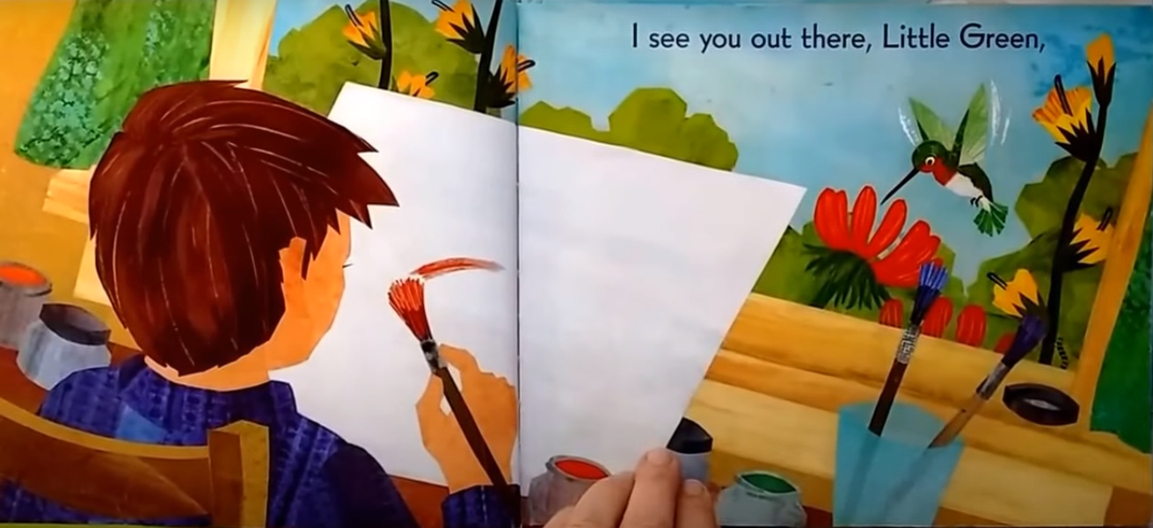
Te veo afuera, Pequeño Verde,

Slide 4
En las flores y en medio,

Slide 5
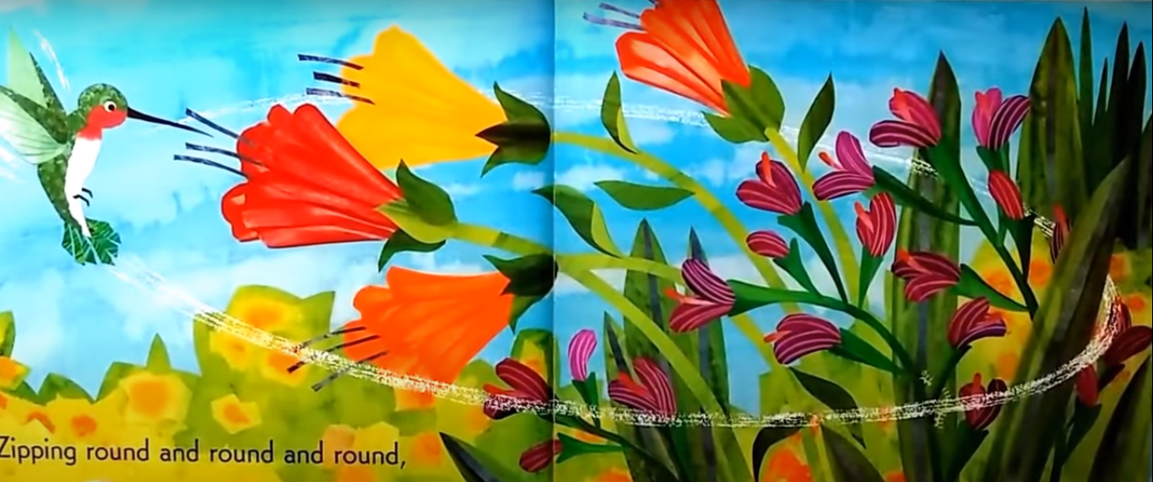
Pasas volando dando vueltas,

Slide 6
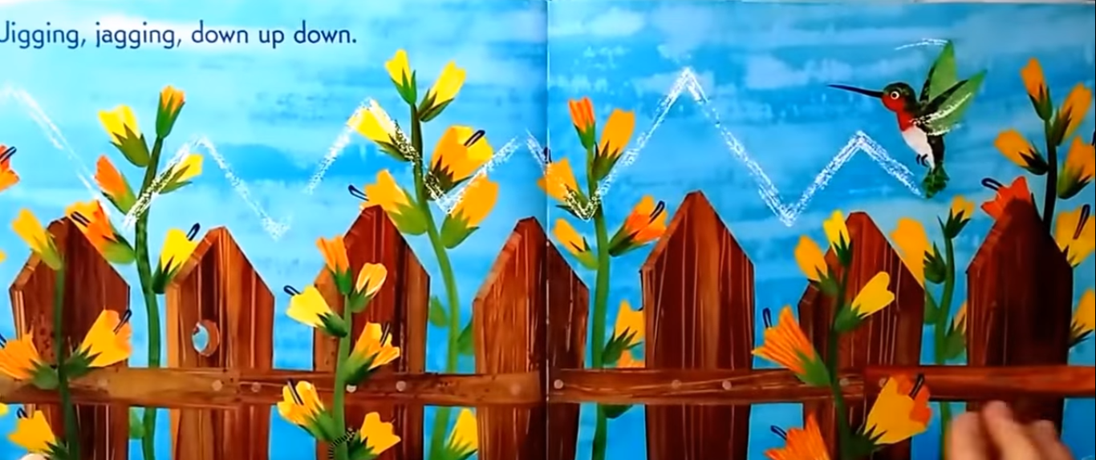
Moviéndote de arriba a abajo,

Slide 7
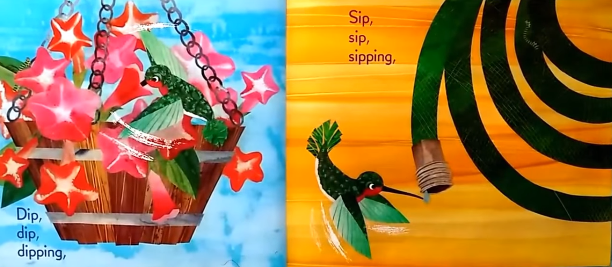
Sorber,
sorber,
sorbiendo,
Meter,
meter,
metiéndote,

Slide 8
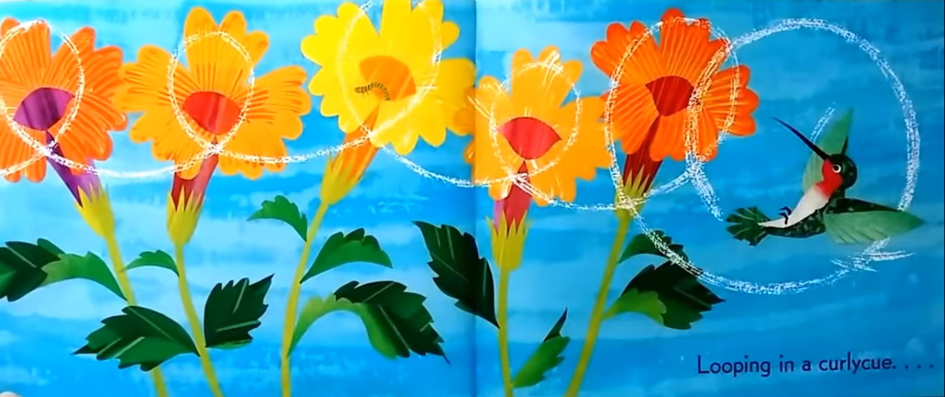
Dando vueltas….

Slide 9
Pequeño verde, todavía te veo.

Slide 10
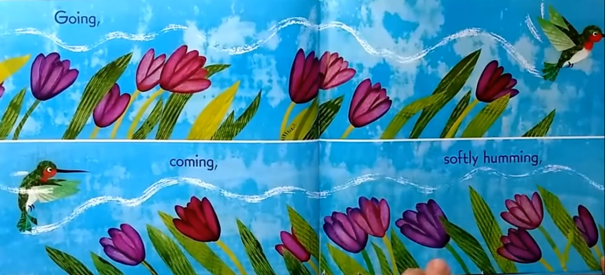
Yendo,
viniendo,
zumbando suavemente,

Slide 11
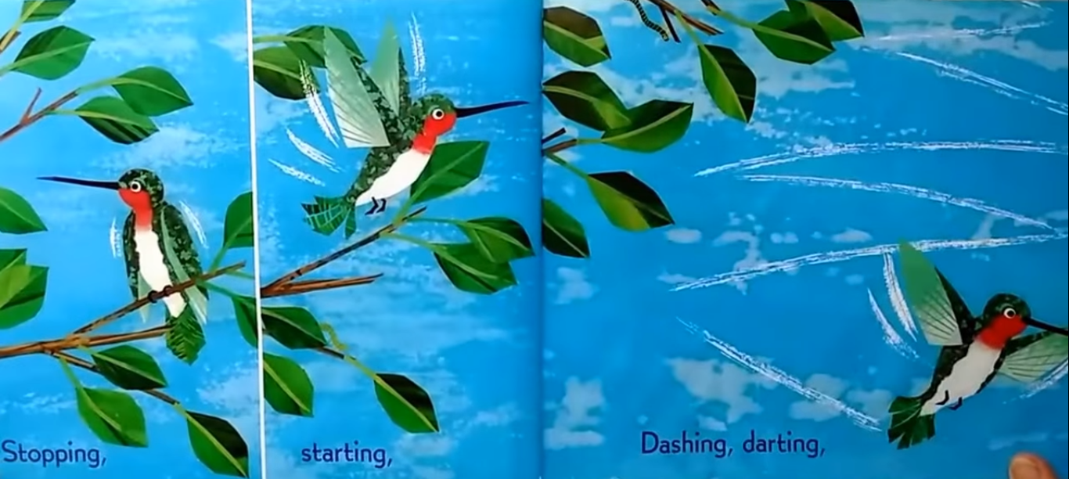
elegante, veloz,
Deteniéndote,
iniciando,

Slide 12
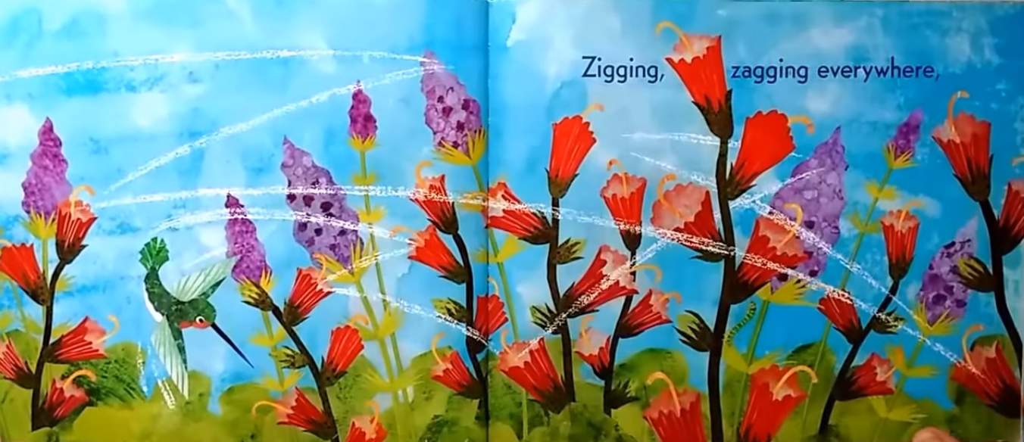
Zigzagueando en todos lados,

Slide 13
Sobrevolando en el aire,

Slide 14
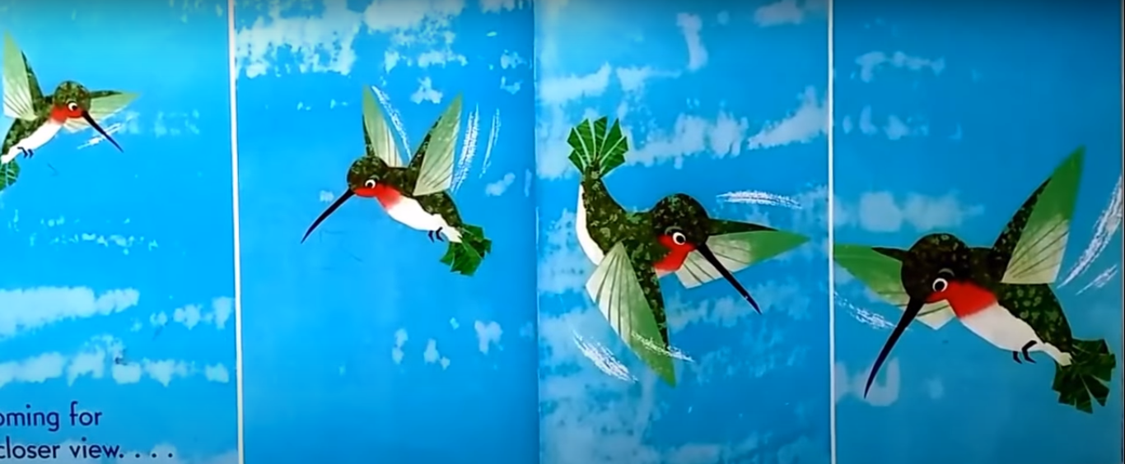
Acercándote a echar un vistazo,

Slide 15
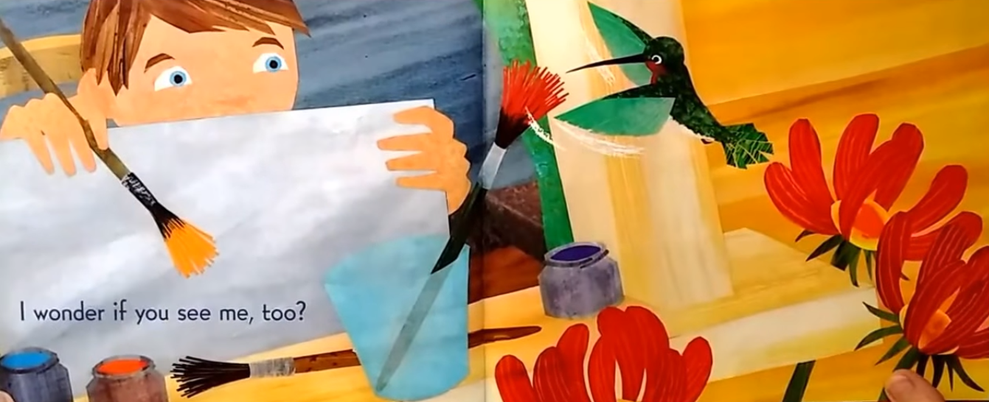
¿Me pregunto si tu también me ves?,

Slide 16
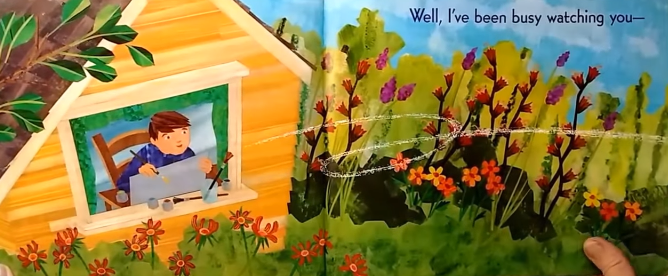
Bueno, yo te he estado observando...

Slide 17
¡Y pintando cómo vuelas !

Slide 18
Hummingbird “Colibrí”
World’s smallest birds, the size of a bee
Beat their wings up to 200 times per second
Only found in North and South America
Only bird that can fly backwards and even upside down

Slide 19
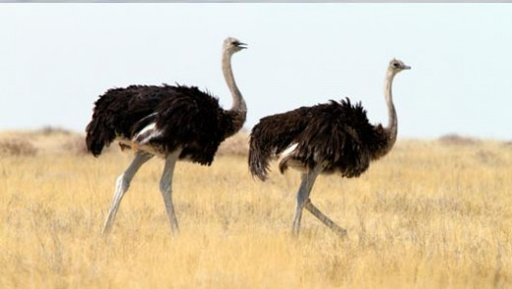
Tipos de pájaros
Ostrich – Avestruz
Notes:
Hibernation is a type of deep sleep an animal enters
Winters is the time when the food becomes scarce.

Slide 20
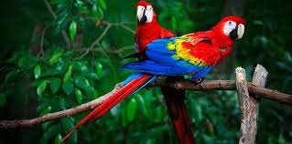
Tipos de pájaros
Parrot – Perico
Notes:
Hibernation is a type of deep sleep an animal enters
Winters is the time when the food becomes scarce.

Slide 21
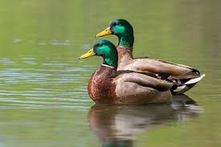
Tipos de pájaros
Duck – Pato
Notes:
Hibernation is a type of deep sleep an animal enters
Winters is the time when the food becomes scarce.

Slide 22
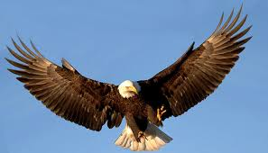
Tipos de pájaros
Eagle – Águila
Notes:
Hibernation is a type of deep sleep an animal enters
Winters is the time when the food becomes scarce.

Slide 23
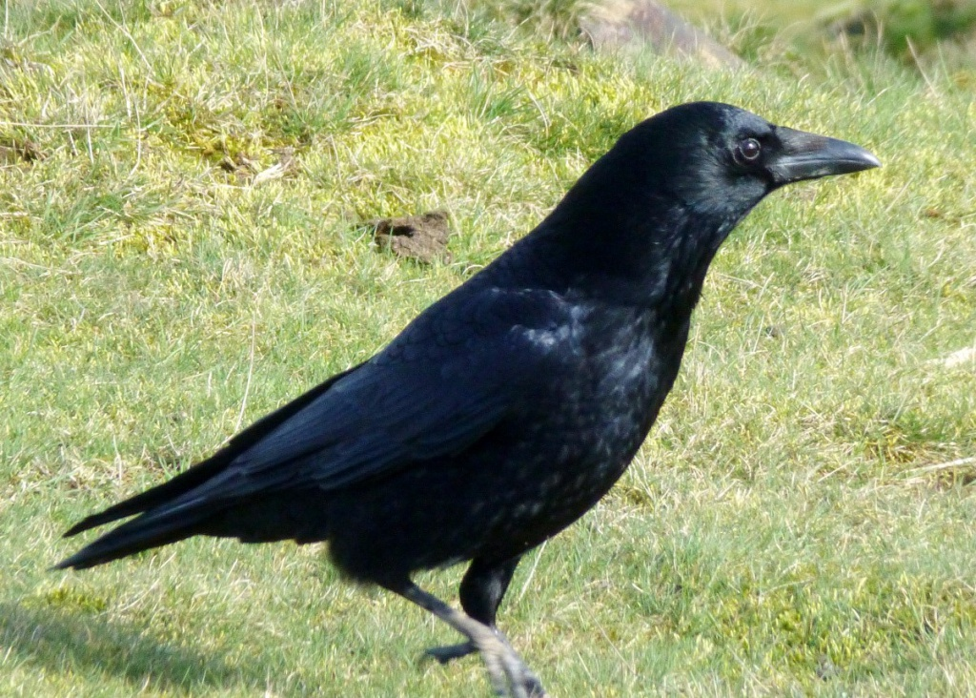
Tipos de pájaros
Carrion Crow – Urraca
Notes:
Hibernation is a type of deep sleep an animal enters
Winters is the time when the food becomes scarce.

Slide 24
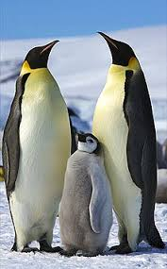
Tipos de pájaros
Penguin – Pingüino
Notes:
Hibernation is a type of deep sleep an animal enters
Winters is the time when the food becomes scarce.

Slide 25
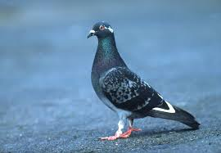
Tipos de pájaros
Pigeon – Pichón
Notes:
Hibernation is a type of deep sleep an animal enters
Winters is the time when the food becomes scarce.

Slide 26
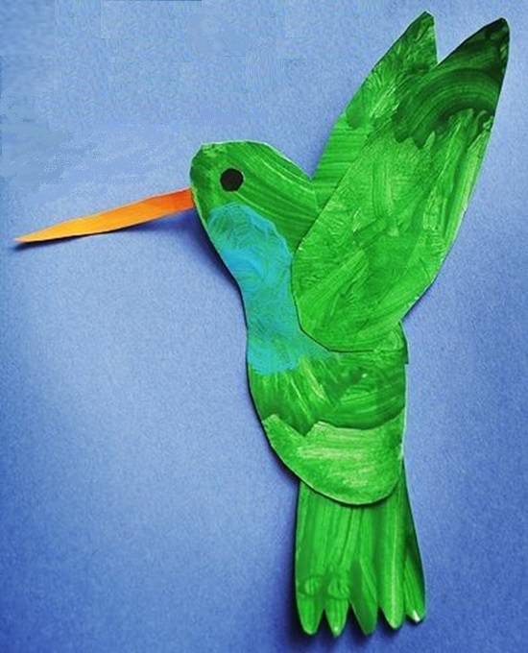
Notes:
Hibernation is a type of deep sleep an animal enters
Winters is the time when the food becomes scarce.

